Slide 1
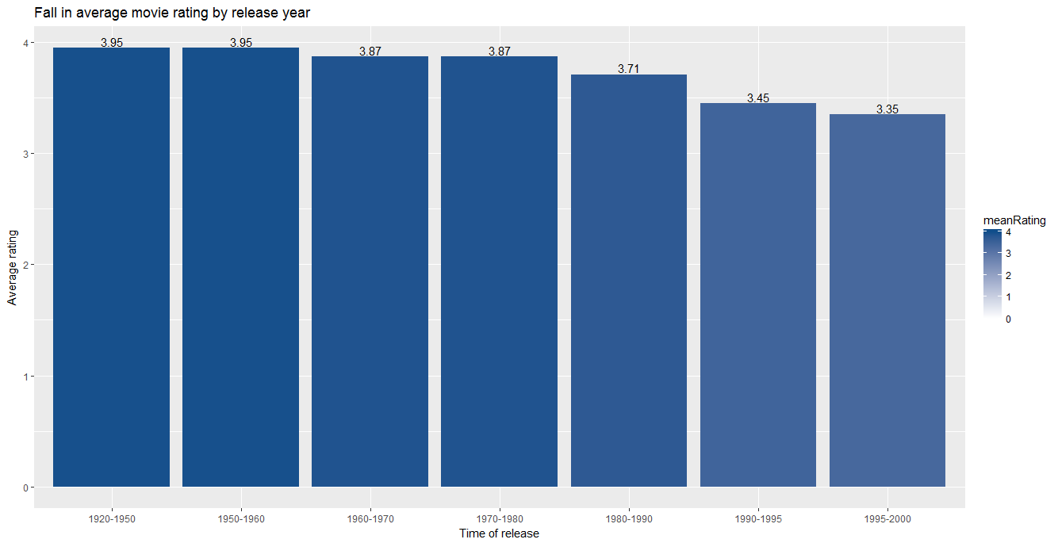

Slide 2
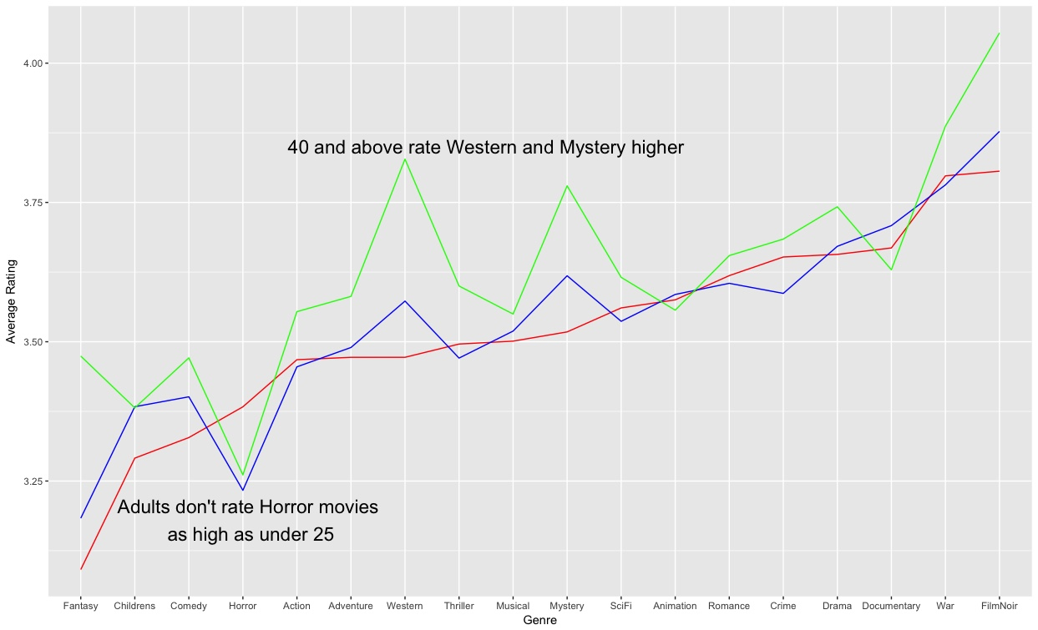
Age 25 and under Age 25 to 40 Age 40 and above

Slide 3
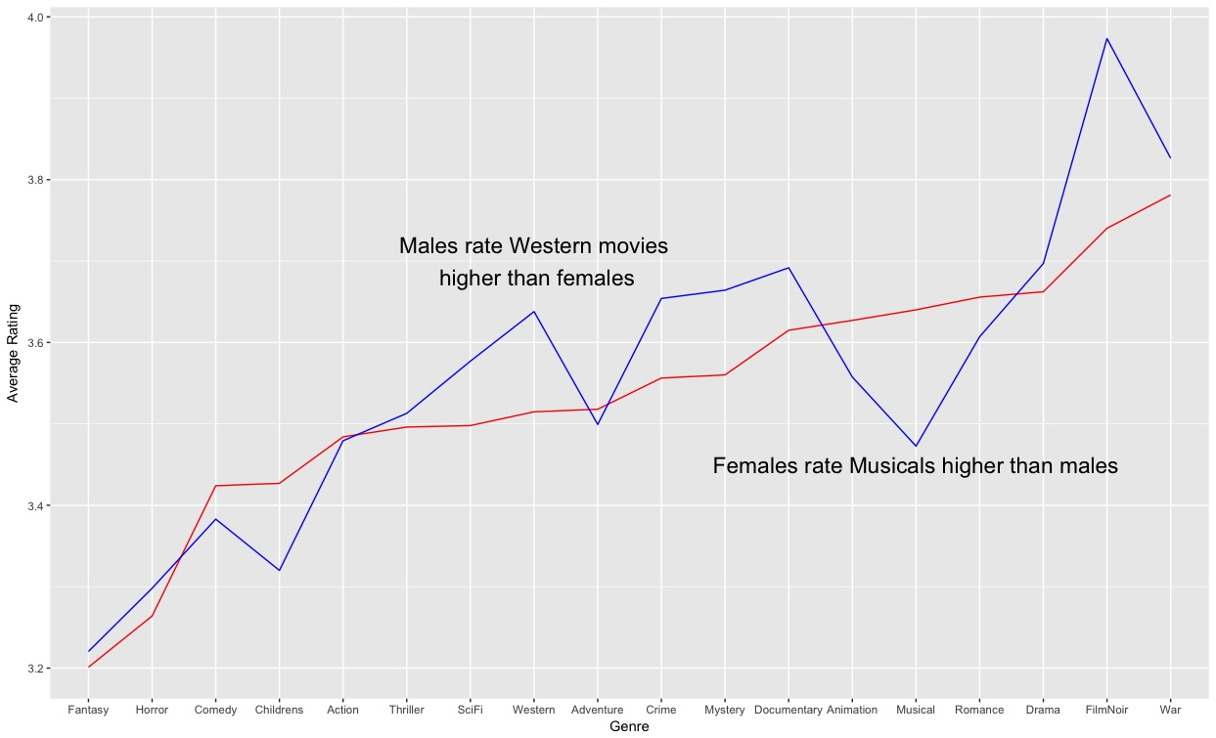
Female Male

